Slide 1

Lecture – 11/8/2016
CSCI 36300 – Software Design

Slide 2
Assignment #4 Questions

Slide 3
Proxy Pattern

Slide 4
Proxy Pattern
Have you ever been in the following situation(s):
Need to use an object, but really do not care about its location.
Load an image from disk.
Have a pointer, but want to add more intelligence to it so it is a LOT easier to use.
Remembering to delete it once it goes out of scope.

Slide 5
Proxy Pattern
Pattern Classification:
Structural Pattern
GOF: pp. 207
Problem:
You do not want to instantiate a complex object unless they are actually requested by the client.
Solution:
Provide a surrogate, as a go-between, in order to provide access to the object as needed.

Slide 6
Proxy Pattern
Motivation:
Using basic pointers can be a headache.
Ideally, we want to have some concept/construct that will know when to delete memory held by a pointer.
int main (int argc, char * argv [])
{
char ch = ‘a’;
char * ch_ptr = &ch;
const char * my_ch = new char ();
};

Slide 7
Proxy Pattern
Pattern Intent:
Provide a surrogate, or placeholder, for another object and control access to it.
The proxy is meant to look and feel like the real object that it is imitating…
“Sits” in-between the actual object and the client.

Slide 8
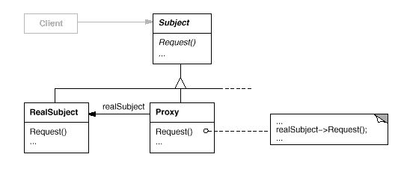
Proxy Pattern

Slide 9
Proxy Pattern
The code in the previous example requires developers to manually delete memory when it is out of scope.
A better solution would be to automatically delete memory when necessary.
int main (int argc, char * argv [])
{
// ...
// automatically delete
pointer my_ch = new char ();
};

Slide 10
Proxy Pattern
Auto Pointers
C++11 Deprecated
Unique Pointer
A template class describes an object that stores a pointer to a single allocated object that ensures that the object to which it points gets destroyed automatically when control leaves a scope.

Slide 11
Proxy Pattern
template <typename T>
class auto_ptr
{
public:
// constructors
auto_ptr (void);
auto_ptr (T * ptr);
// desturctor
~auto_ptr (void);
// operator overloading
T * operator -> (void);
T & operator * (void);
operator T * (void);
private:
// pointer to the memory
T * ptr_;
};

Slide 12
Proxy Pattern
template <typename T>
class auto_ptr
{
public:
// constructors
auto_ptr (void) : ptr_ (0) { }
auto_ptr (T * ptr) : ptr_ (ptr) { }
// desturctor
~auto_ptr (void) {
if (0 != this->ptr_)
delete this->ptr_;
}
T * operator -> (void) { return this->ptr_; }
T & operator * (void) { return *this->ptr_; }
operator T * (void) { return this->ptr_; }
private:
// pointer to the memory
T * ptr_;
};

Slide 13
Proxy Pattern
Here we think we are dealing with a pointer but we are actually using the Proxy pattern to use the Auto Pointer which gives us the benefit of automatic memory management.
The constructor initializes the contained ptr_ accordingly.
The destructor automatically deletes memory owned by ptr_.
The overloaded operators enable access to the encapsulated ptr_ and its memory.

Slide 14
Proxy Pattern
What is wrong with the following block of code?
void do_something (void)
{
int * int_ptr = new int ();
// ...
*int_ptr = 5
// delete memory when done
delete int_ptr;
}

Slide 15
Proxy Pattern
If by chance something would go wrong within the do_something method we would have a memory leak as the pointer would not be “cleaned up.”
How could we potentially alleviate this problem – assuming we still want to use a pointer here?

Slide 16
Proxy Pattern
By using an auto_ptr to manage memory, if control returns abruptly from do_something, then we are guaranteed that the memory will be deleted.
void do_something (void)
{
auto_ptr <int> int_ptr = new int ();
// ...
// using overloaded operator *
*int_ptr = 5
}

Slide 17
Proxy Pattern
Auto Pointer Benefits:
We can use this with ADT’s…not just with primitives (e.g., integers).
Overloaded operators allow this functionality to behave seamless to the client.
Are we dealing with the actual pointer or the auto pointer – do we know? Do we care?

Slide 18
Proxy Pattern
Can we simply include the template class for Auto Pointer into our existing project to deal with say the Array?
class Array
{
// ...
private:
char * data_;
size_t cur_size_;
size_t max-size_;
};

Slide 19
Proxy Pattern
What about additional operator overloads that the pointer may reference in this case – [] in the case of an Array.
We need to create a specialized implementation of the Auto Pointer in order to properly handle the behavior, or semantics, of the Array.

Slide 20
Proxy Pattern
template <typename T>
class array_auto_ptr
{
public:
// constructors
array_auto_ptr (void);
array_auto_ptr (T * ptr);
// desturctor
~array_auto_ptr (void);
// operator overloading
T * operator -> (void);
T & operator * (void);
operator T * (void);
T & operator [] (int i);
private:
// pointer to the memory
T * ptr_;
};

Slide 21
Proxy Pattern
Implementation:
class Array
{
~Array (void)
{
// array_auto_ptr handles delete for you!!
}
private:
array_auto_ptr <char> data_;
size_t cur_size_;
size_t max_size_;
};

Slide 22

Proxy Pattern
Boost Library
Various tools and frameworks included.
Unit Testing
Unique Pointers
Explicitly prevents copying of its contained pointer.
Shared Pointers
Allows for sharing and corresponding removal of a pointer.
https://github.com/boostorg/boost

Slide 23
Proxy Pattern
The C++11 specification introduces 3 new smart pointers for managing memory allocations:
unique_ptr – a smart pointer that retains sole ownership of an object through a pointer
shared_ptr – a smart pointer that manages lifetime of an object, typically allocated with new
weak_ptr – a smart pointer that holds a non-owning (“weak”) reference to an object that is managed by std::shared_ptr. It must be converted to std::shared_ptr in order to access the referenced object

Slide 24
Proxy Pattern
All this talk about pointers has made my head hurt….
What about the Proxy pattern?
It is simply a wrapper here that allows us to hide some of the complexity from the client. We add a layer of indirection between the client and the real object that we are working with.
Potential side effects of this approach?

Slide 25
Proxy Pattern
Consequences:
Introduces a level of indirection when accessing the underlying object.
Copy-on-Write
Which is the idea of copying an object only after you begin to write to it.
Too much indirection?
What if we need to know what the underlying “real” object is doing?
A change in the interface impacts the proxy as well.

Slide 26
Quiz #13

Slide 27
Façade Pattern

Slide 28
(Wrapper) Façade Pattern
Have you ever been in one of the following situations:
Dealing with many interacting objects (or subsystems) to achieve some higher-level functionality.
Working with low-level functionality and APIs, and need to logically coordinate invocations.
Need to shield developers from low-level functionality so they can focus on achieving high-level goals.
Dealing with the same concept that must be implemented on many different machines and platforms.

Slide 29
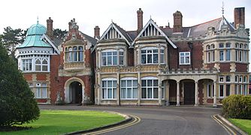
Façade Pattern
A façade is an object that provides a simplified interface to a larger body of code.
Architectural Façade
“Front Facing”
Pattern Classification:
Structural Pattern
GOF: pp. 185
Defines a higher-level interface that makes the subsystem easier to use.

Slide 30
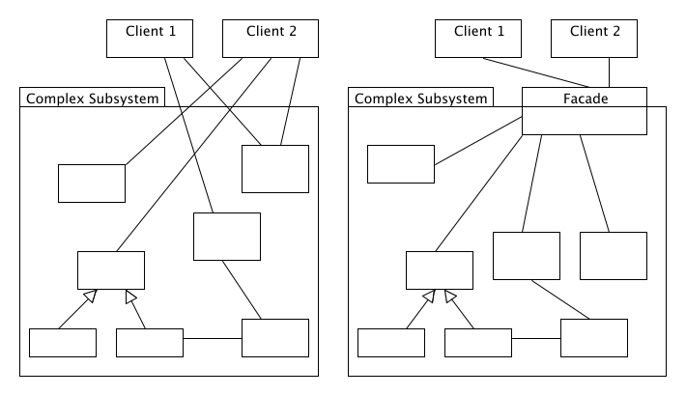
Façade Pattern
http://best-practice-software-engineering.ifs.tuwien.ac.at/patterns/facade.html

Slide 31
Façade Pattern
What are some potential problems with the following code:
int main(int argc, char * argv []) {
char a1[3] = {‘C’, ‘S’, ‘I’};
// find the ‘C’
int i = 0;
for (i = 1; i <= 3; ++ i)
if (a1[i] == ‘C’)
break;
char * a2 = new char[5];
// find the ‘I’ in a1
int i = 0;
for (i = 0; i <= 5; ++ i)
if (a1[i] == ‘C’)
break;
}

Slide 32
Façade Pattern
Potential problems with the code on the previous slide:
Developer is responsible for knowing that array’s use 0-based indexing.
We can’t always assume…
Developer is responsible manually keeping track of what size belongs to what array (e.g., a1 and a2).
This is a simple/trivial program – just image a real software system.

Slide 33
Façade Pattern
How did we deal with this in our Array class?
int main(int argc, char * argv []) {
// create an array of size 3
// initialize contents to “CSI”
Array a1 (“CSI”, 3);
// find the ‘C’
size_t pos = a.find (‘C’);
Array a2 (5);
// find the ‘I’ in a1
size_t pos = a1.find (‘I’);
}

Slide 34
Façade Pattern
Need for a simplified interface to the overall functionality of a complex system.
Reduces subsystem coupling.
Provides an abstract coupling between the façade abstract class and the concrete subclasses for different implementation of a subsystem.
Related Patterns:
Abstract Factory
Mediator

Slide 35
Façade Pattern Benefits
Protects the user from the complex details of the system.
Provides simplified view
Provides ease of Use
Decouples the code that uses the system from the details of the subsystems, making it easier to modify the system later.
Layered System Architecture

Slide 36
Façade Pattern: Example
Vending Machine Example
Purchase Coffee
Push Button → Get Coffee
More to this entire scenario…
What are the components we are interacting with?
What purpose does the façade serve in this example?
Flight & Hotel Booking Example
Travel Façade

